Slide 1

Team Name : WeBlunders
Team Leader Name : Muskan Shaikh
Problem Statement : To protect citizens from cybercrime and online exploitation.

Slide 2

Brief about the Idea:
This project is an AI-powered safety assistant designed to protect citizens from digital scams such as OTP fraud, fake KYC updates, and WhatsApp link scams.
The system detects suspicious messages, links, and calls in real time and immediately alerts the user. It also includes a multilingual voice assistant feature so that elderly people and non-technical users can easily understand warnings and use the app without difficulty.
The goal is to make digital safety simple, accessible, and secure for every citizen.

Slide 3
🔍 How Is It Different from Existing Solutions?
Most existing apps only detect spam calls or block unknown numbers.
Our solution focuses specifically on Indian scam patterns like OTP fraud, fake KYC updates, and WhatsApp link scams.
Includes a real-time AI alert system, not just a spam database.
Provides multilingual voice assistance, making it usable for elderly and non-technical users.
Designed specially for digital beginners and rural users, not just tech-savvy people

Slide 4
🛡️ How Will It Solve the Problem?
Scans SMS, WhatsApp messages, and suspicious links using AI. Detects scam keywords like “KYC expired”, “Update PAN”, “Share OTP”
, “Urgent bank action”.
Gives instant warning alerts before the user clicks or shares OTP.
Voice assistant explains the risk in simple language.
Educates users with small safety tips after detecting fraud attempts.
Result: ➡ Prevents financial loss ➡ Protects vulnerable users ➡ Builds digital awareness

Slide 5
⭐ USP (Unique Selling Proposition)
🔊 Voice-based scam alerts in multiple Indian languages
🇮🇳 Focused on Indian scam ecosystem
🤖 AI-based real-time detection (not just number blocking)
👵 Designed for elderly & low digital literacy users
📱 Simple, one-click protection system

Slide 6
🛡️ Key Features of the AI Scam Protection Assistant
🔐 1. Real-Time Scam Detection
Scans SMS, WhatsApp messages & links instantly.
📩 2. OTP & KYC Fraud Alert
Warns users before sharing OTP or clicking fake bank/KYC links.
🔊 3. Multilingual Voice Assistant
Explains alerts in simple language (Hindi, English, regional languages).
🚨 4. Instant Risk Notification
Red warning pop-up before risky action.
👵 5. Elderly-Friendly Mode
Large buttons, simple interface, voice guidance.
📊 6. Scam Awareness Tips
Educates users after detecting suspicious activity.
.

Slide 7
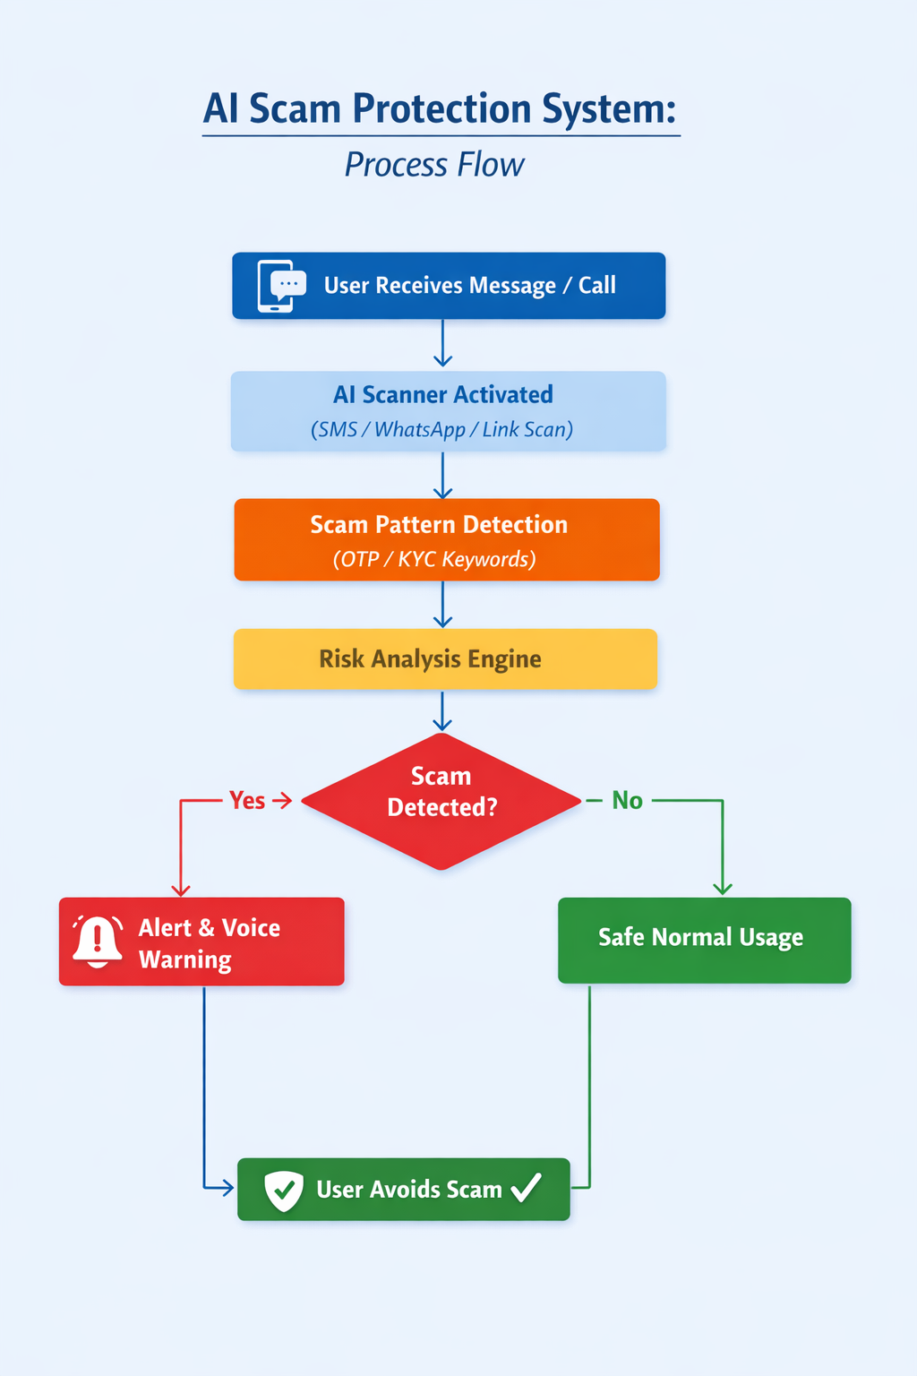
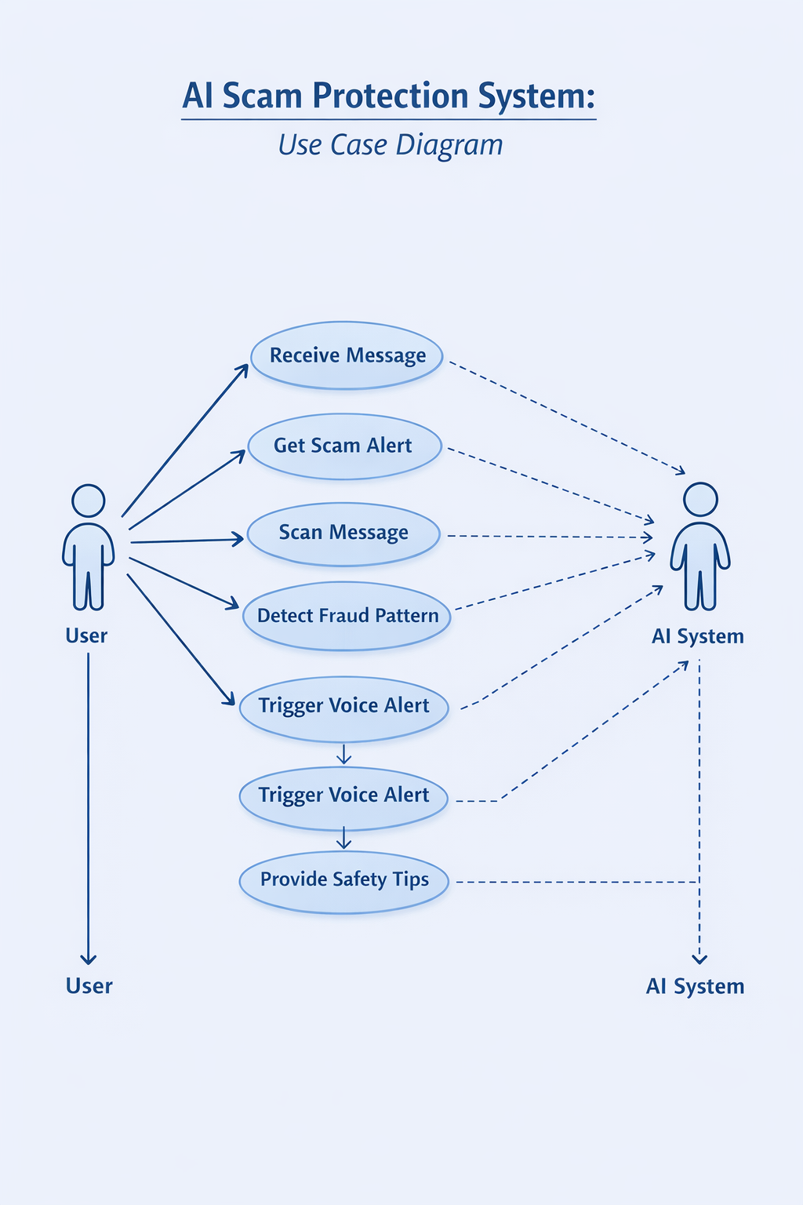

Slide 8
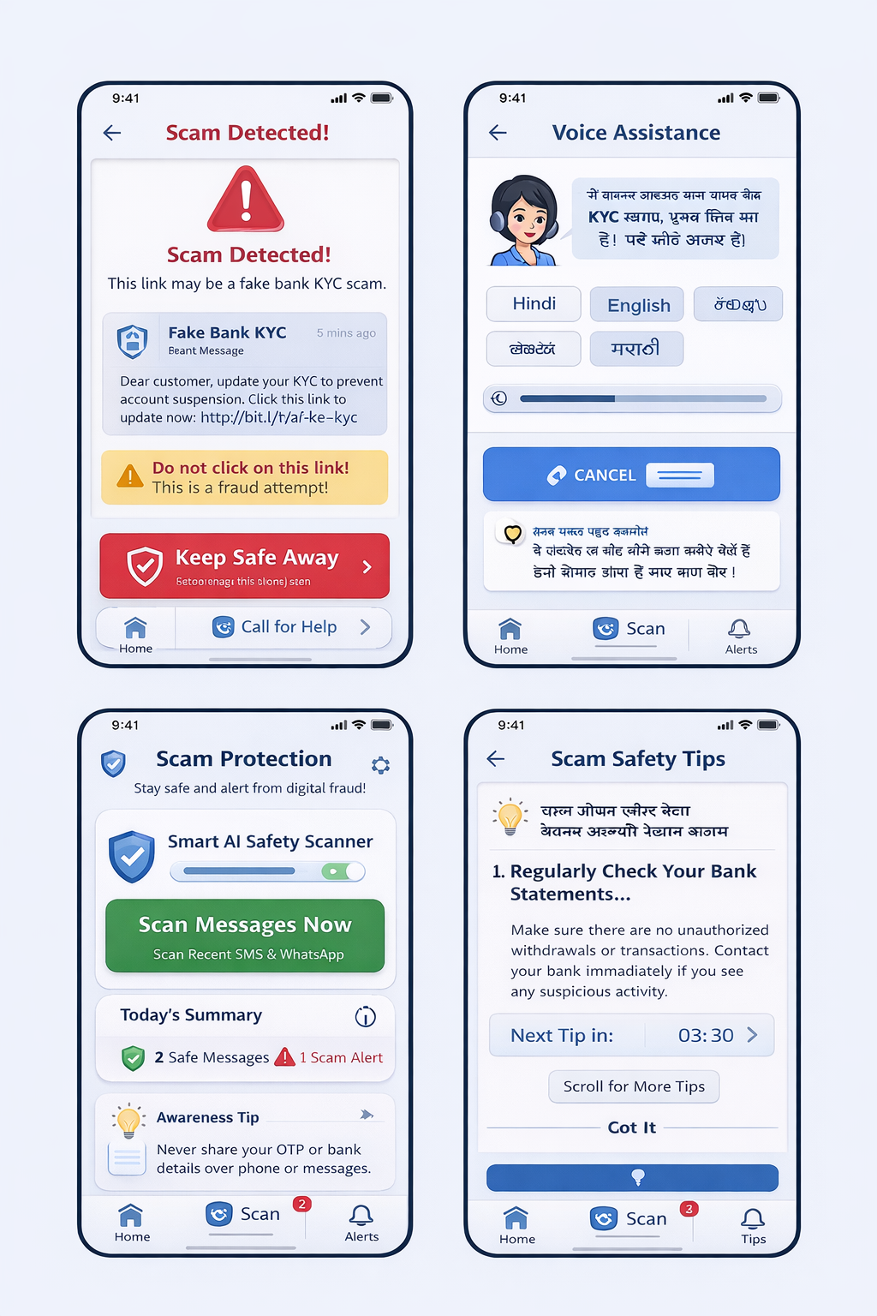

Slide 9
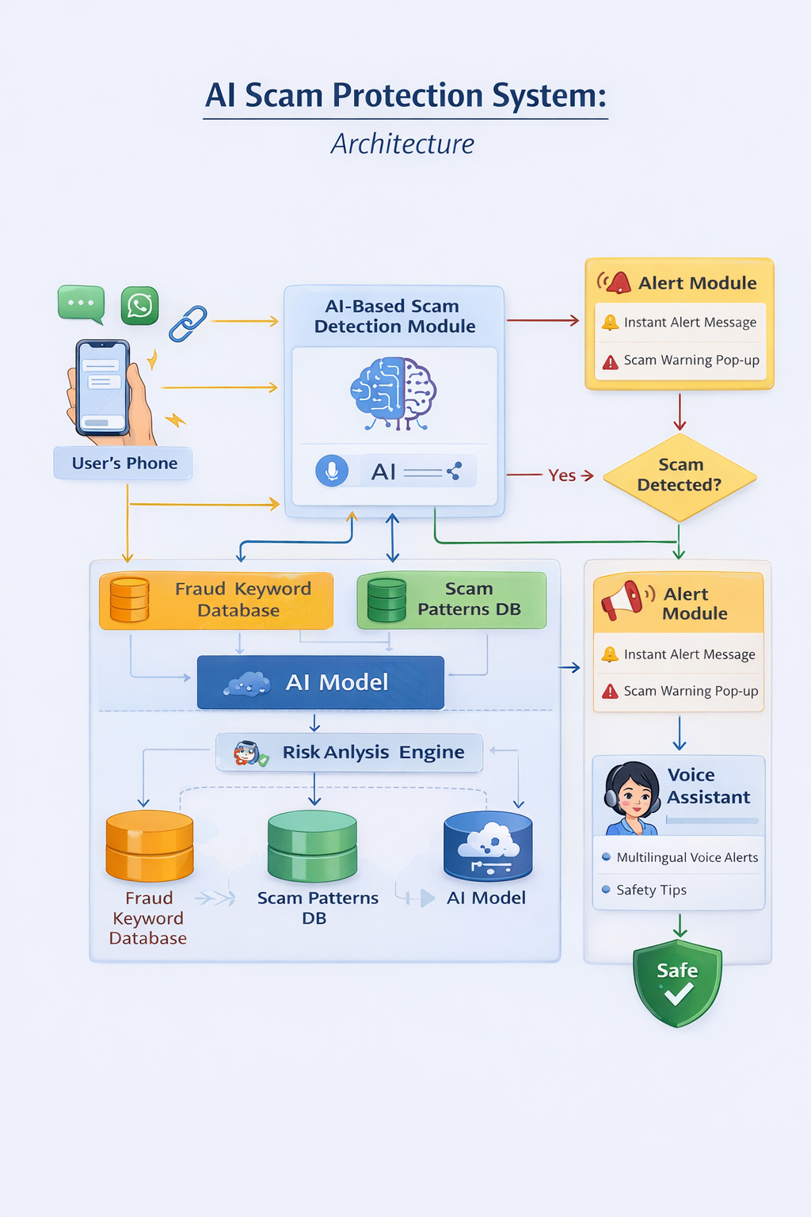
:

Slide 10
Technologies to be used in the solution:
Frontend: Flutter / React Native
Backend: Node.js / Django
AI Model: Python + NLP
Database: Firebase / MongoDB
Voice Tech: Google TTS API
Cloud: AWS / GCP

Slide 11


